Slide 1
B401 Final Presentation
Widespread endogenization of giant viruses
shapes genomes of green algae
Mohammad Moniruzzaman1, Alaina R. Weinheimer1, Carolina A. Martinez-Gutierrez1
& Frank O. Aylward1
Presentation by: Logan Clarke

Slide 2
Introduction
    The purpose of this paper was to show that several different species of green algae have been endogenized by Nucleocytoplasmic Large DNA Viruses (NCLDVs). That is to say many different species of green algae contain genes that were transferred to them from NCLDVs.
    This is a significant finding as it provides evidence that Giant Endogenous Viral Elements (GEVEs) play a significant role in eukaryotic genome evolution and thus many eukaryotic lineages have access to a much larger array of genomic material than previously thought.

Slide 3
My Contribution - Analysis Tasks
Step 1 – Viral Recall
    Different results from authors
Step 2 – Hybrid Gene Prediction
    Augustus not predicting same genes as authors
Step 3 – Homology searches
    Require refseq download
Step 4 – NCVOG HMM database
Step 5 – Analysis of GEVEs by TNF
    New results
Step 6 - Phylogenetic analysis of NCLDV hallmark genes
Step 6.1 – Construction of NCLDV Hallmark protein HMM profiles (used by viral recall)
Step 7 – GEVE genome plots
Step 8 - Independent validation of introns using RNA sequencing data
Step 9 - Bipartite network of GEVEs and reference NCLDV genomes
Step 10 - Intron sharing and gene sharing analysis
Step 11 - Calculation of dn/ds ratio
Step 12 - Duplication Level Synteny Analysis
Step 13 - Functional Annotation
Step 14 - Phylogeny of Host Algae

Slide 4
Viral Recall
Viral recall analysis summary
  Prodigal finds protein coding regions
  Hmmer3 takes prodigal output, runs it through the PFAM and GVOG hmm databases
    Score = GVOG score – PFAM score
    Rolling mean across 15 ORF
    Net positive score designate viral regions
  Hmmer3 takes prodigal output, compares it to 10 custom HMMs for NCLDV hallmark genes.
  Viral recall produces summary statistics for viral regions indicating viral region scoring and which regions contained hallmark genes.

Slide 5
Viral Recall
Viral Recall Results
  Authors selected 73 out of 5854 scaffolds for their T. Socialis GEVES
  My run of Viral recall identified 92 viral regions (some within the same scaffold)
  My results match 56 out of the 73 final contigs chosen by the authors
Inconsistencies
  Missing nearly 20 viral regions identified by authors
  Authors stated VOG db used, though viral recall default uses GVOG db
  Authors stated viral recall score of 10 was used, though the default score is 1
python viralrecall.py -i TetSoc_Query/GCA_002891735.1/GCA_002891735.1_TetSoc1_genomic.fna -p TetSoc_GVOG -t 2

Slide 6
Viral Recall
Inconsistencies Resolved
Missing viral regions due to the extensive manual curation the authors used to identify additional viral regions.
  “...Please be aware that the final viral contigs are not just the raw viralrecall results...We also did a very extensive and time-consuming manual curation step...about 2/3rd of the reported viral contigs (as you mentioned) come from the viralrecall search”
Use of GVOG DB improves viral recall results as this is the updated version of VOG db and as such has effectively replaced VOG db
Viral recall scores are sq rt transformed
  “And yes, the default value of '-s' flag is 1 for the latest version of viralrecall, since the score values are now square root transformed”

Slide 7
Analysis of Geve by TNF
TNF Summary
    Binning the viral contigs into GEVE requires calculation of pearson correlation of the TNF of viral regions(Contigs with best viral recall scores) compared to the eukaryotic regions ( contigs with the lowest viral recall score)
    This task requires writing a script in R using the biostrings package.
  Inconsistencies
    Initially my TNF results did not show a negative correlation between the TNF of viral regions and eukaryotic regions
    A few details regarding the calculation that were not mentioned by the authors and some ambiguities within the description they provided turned out to be the main cause of these poor results.
    Inspecting the authors TNF script allowed me to resolve all inconsistencies and better understand how the calculation is performed.

Slide 8
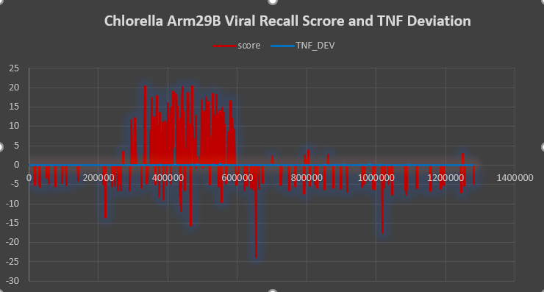
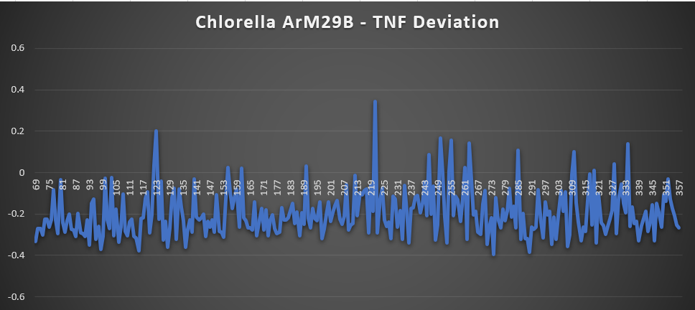
Analysis of GEVE by TNF
Initial TNF Script
vRegions<-list.files(path="C:\\PATH_TO\\ViralRegions", full.names=TRUE)
files <- open_input_files(vRegions)
DNA_Set<-readDNAStringSet(files)
TNF_Set <- oligonucleotideFrequency(DNA_Set,4,step=300)
TNF_Set[1,]
print(length(DNA_Set))
size <- length(DNA_Set)
pearson<-0
for(i in 1:(size-1)){
pearson[i] <- sum ( (TNF_Set[i,] - mean(TNF_Set[i,])) * (TNF_Set[size,] - mean(TNF_Set[size,])) ) /
sqrt ( sum ( (TNF_Set[i,] - mean(TNF_Set[i,])) * (TNF_Set[i,] - mean(TNF_Set[i,])) ) *
sum ( (TNF_Set[size,] - mean(TNF_Set[size,])) * (TNF_Set[size,] - mean(TNF_Set[size,])) ) )
names(pearson)[i]<-paste0(first_line)
print(pearson[i])

Slide 9
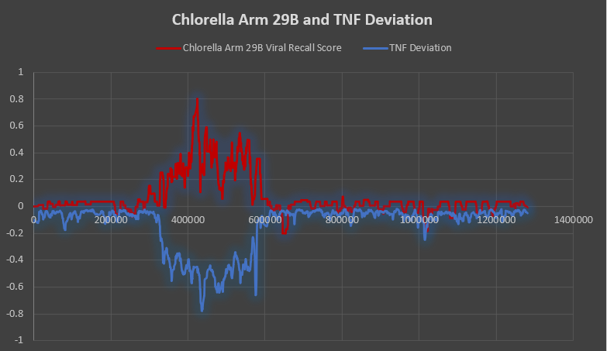
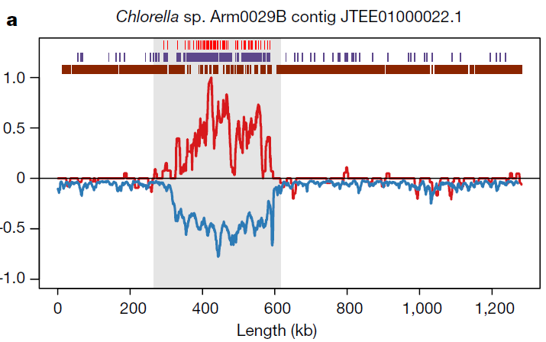
Chlorella Arm 29B

Slide 10
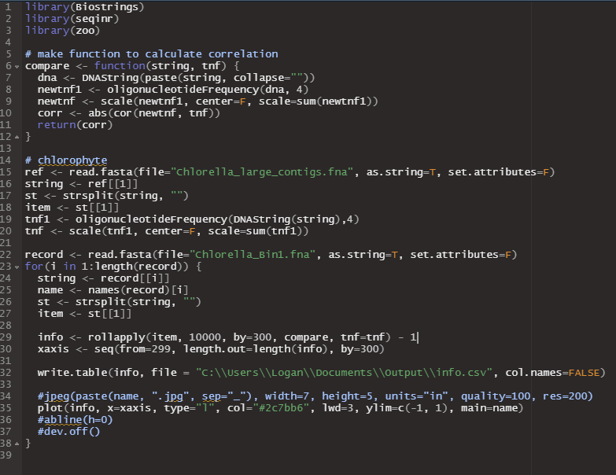
Analysis of Geve by TNF
Inconsistencies Resolved
1) Scale the TNFs before calculating the pearson correlation
    The scale function in r, essentially just normalizes the values in the array of TNFs using the mean and std dev,
    Scaling of the TNFs was not mentioned in the paper.
    However, it should be intuitive since correlating the TNF of small sequences 300bp and a large set of eukaryotic contigs 1mbp doesn’t make sense

Slide 11
Analysis of Geve by TNF
2) The 300bp sliding window, refers to segmenting the viral contig into 300bp regions using the rollapply function
    The oligonucleotidefrequency function which is used to calculate TNF has a step parameter that is said to “adjust the sliding window for the TNF calculation”.
    This caused some ambiguity since the authors simply stated they “...calculated the TNF across a 300 bp sliding window.”
    To segment the viral contigs, the authors used the rollapply r function.
    This function allows you to apply a function iteratively to a segmented data set where you specify the segment size with the “by” parameter

Slide 12
Analysis of Geve by TNF
3) Finally, the values the authors plot are the actually a rolling average of Pearson correlation R values. These values are found using a window size of 10000bp which spans about 30 segments
    The rollapply r function also performs this utility.
    The second parameter to the function called the “width” is the width of a window across which a rolling average is calculated for all values within that window.
    The window size for the rolling average has a large effect on the output data.
    While attempting to display the negative correlation between the TNF of a viral region within a contig and the set of large eukaryotic contigs, the best results I found were by adjusting the rolling average window size to about 1/10th of the size of the viral region within the contig.

Slide 13
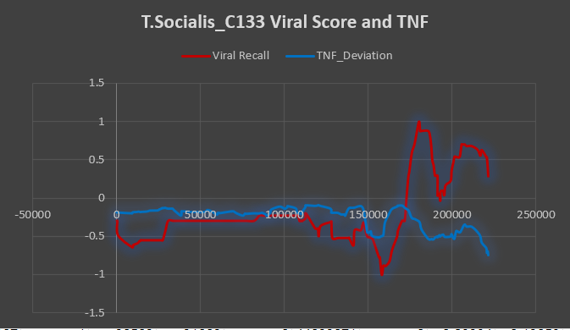
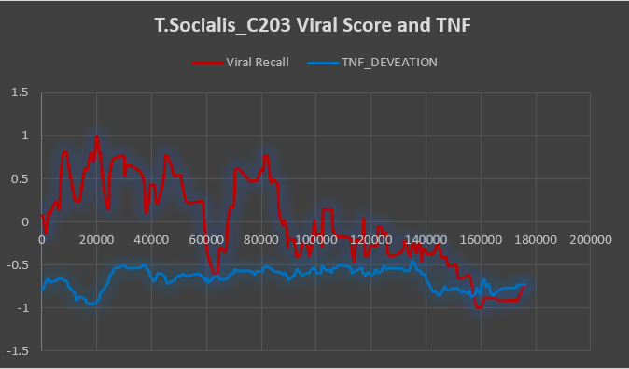
T.Socialis

Slide 14
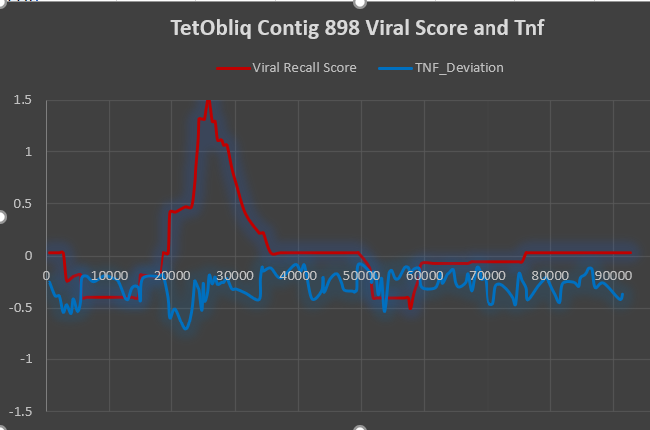
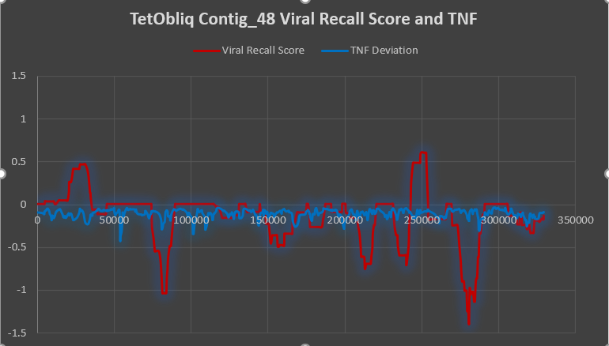
T.Obliquus

Slide 15
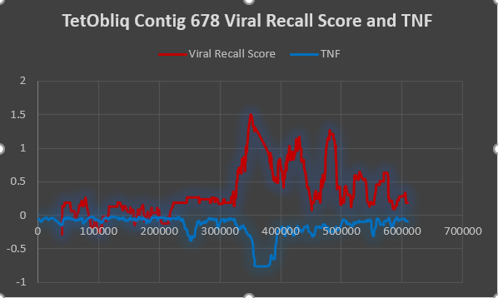
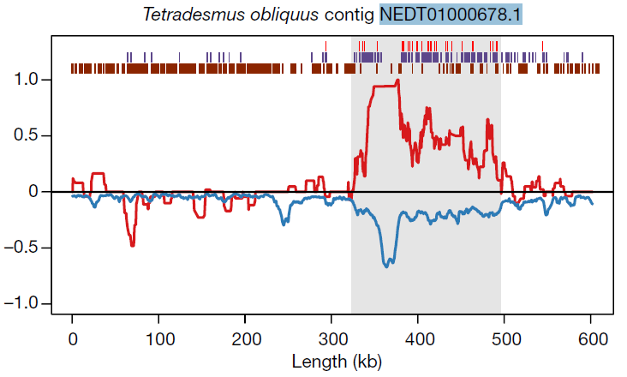
T.Obliquus

Slide 16
Discussion of TNF Results
Overall their does appear to be a relationship bettween the viral recall score and the Pearson correlation of the TNFs
However, the relationship is only obvious to notice in chlorophyte contigs that have very distinct large viral regions
Smaller viral regions, and those contigs which have more dispersed viral recall scores, do not display that relationship very well at all
So it makes sense this data is not used as a primary indicator for finding viral regions as the relationship can be difficult to identify and may not exist is some cases.

Slide 17
Conclusion
Though the analysis was somewhat difficult and extensive, my contribution to replicating this study did provide evidence that the authors claim of green algae being endogenized by NCLDVs is correct.
My attempt to recreate the analysis done in this paper allowed me gain a greater understanding the bioinformatics tools and processes used to perform each analysis.
Specifically, the use of prokaryotic gene finding software and hidden markov models used for homology searches allowed the initial identification of the viral genes located withing green algae genomes. Downstream analysis showing the negative correlation of TNF between viral and eukaryotic regions within the green algae genomes provided further evidence of the authors claim.

